Slide 1

INFORMATION

Slide 2

COMMUNICATION

Slide 3

HUH????????

Slide 4

HALF KNOWLEDGE

Slide 5

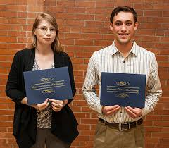
Did you know?
“ Dennis Nilson, a Mexican student, has found the cure for Coeliac disease with the help of his chemistry teacher in his backyard. “
– Mex News

Slide 6


Slide 7
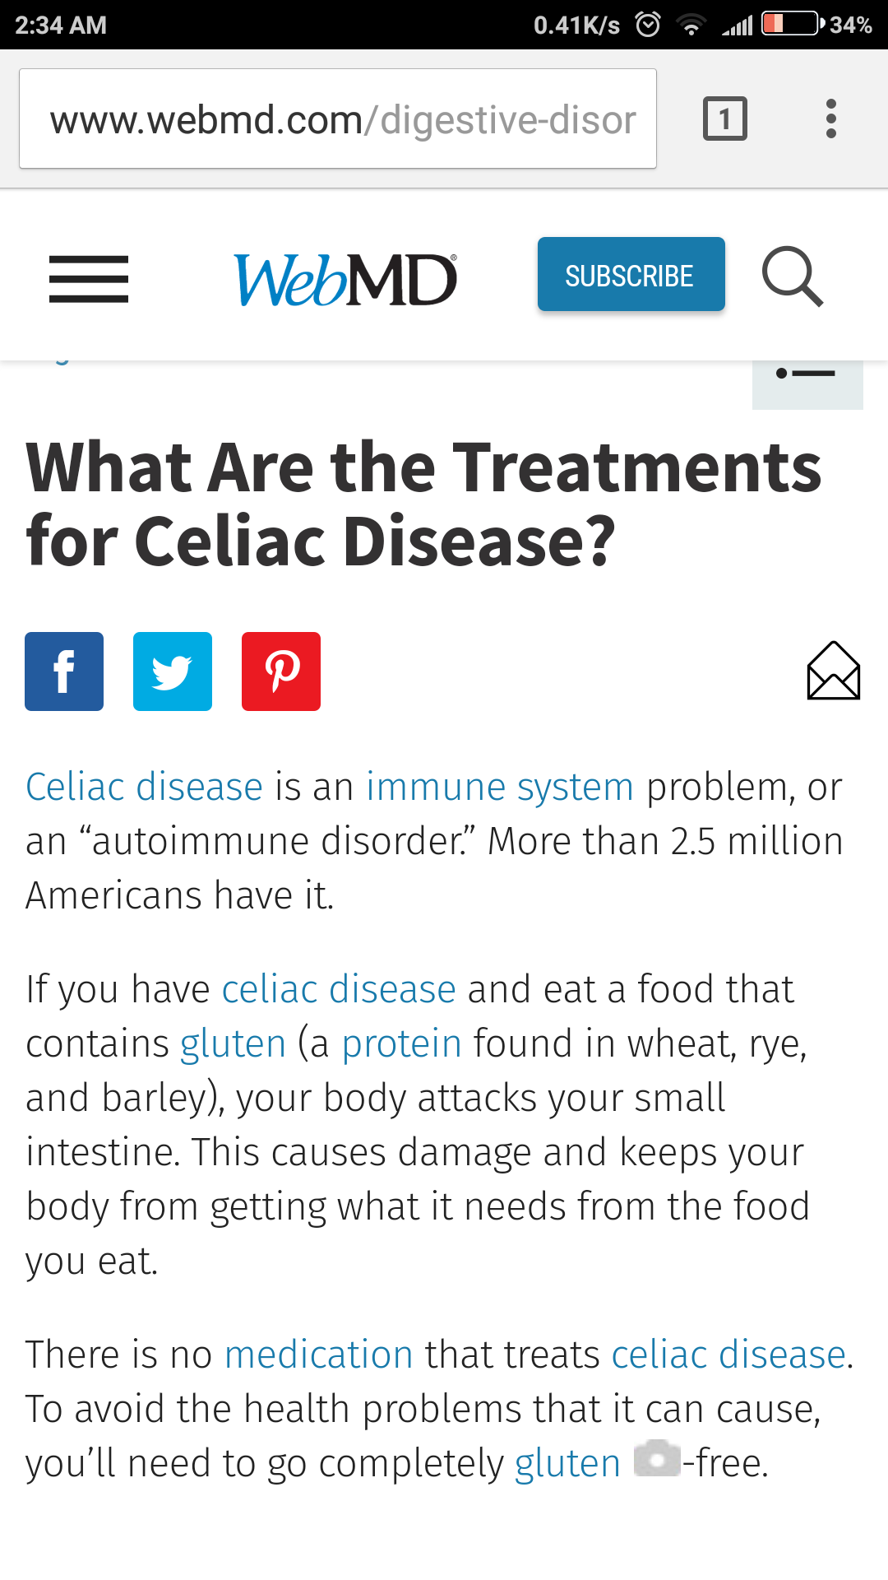

Slide 8
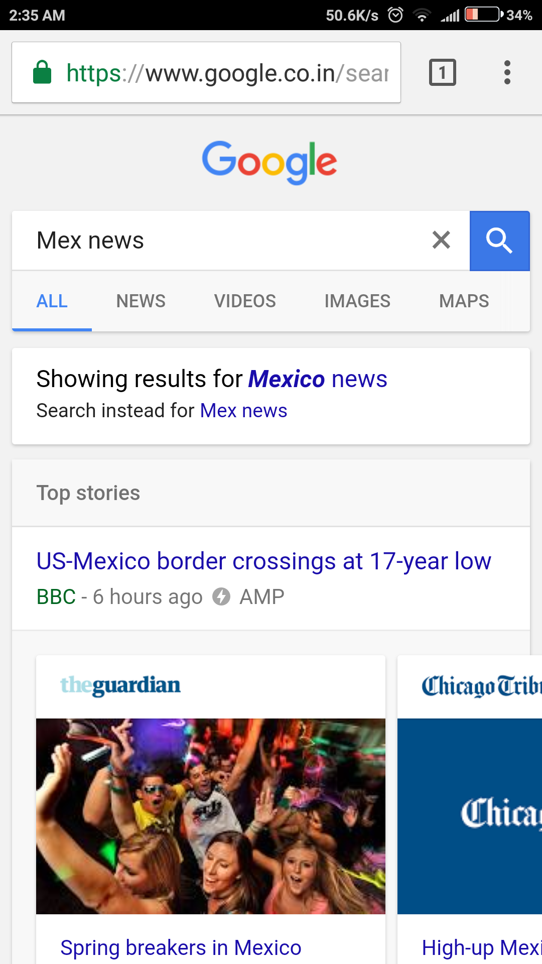

Slide 9
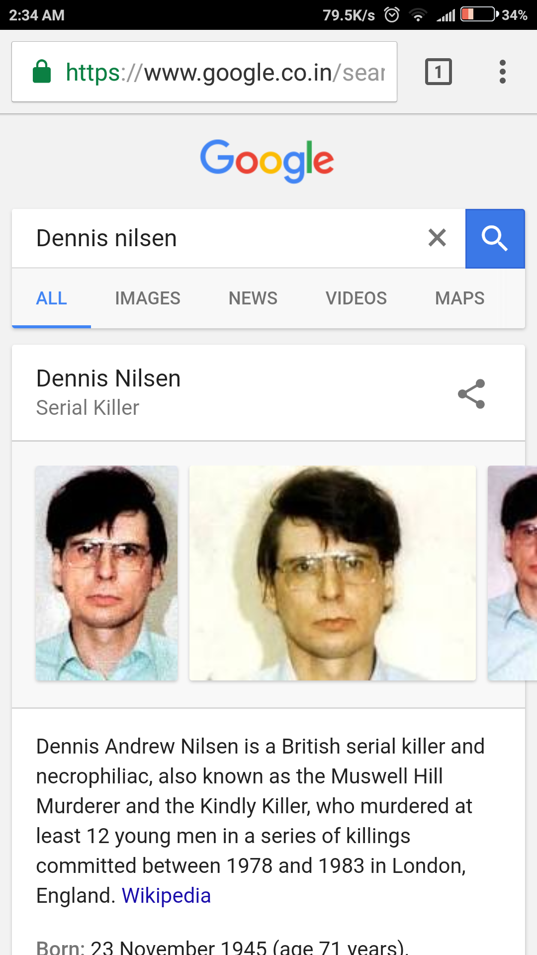

Slide 10

QUOTES

Slide 11
QUOTES
KNOW YOUR SOURCES

Slide 12
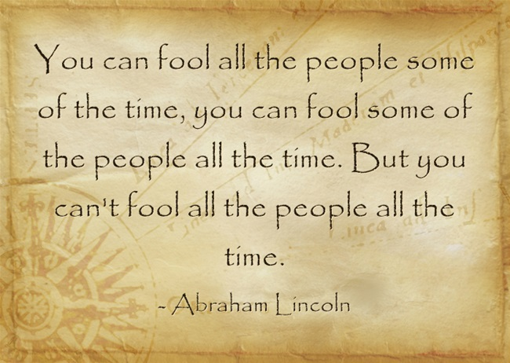
WISE WORDS

Slide 14


SECRETS

Slide 15
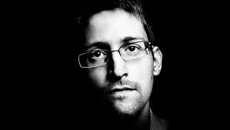

Slide 16
Information is power. Disinformation is abuse of power.

Slide 17
Thank You

